Slide 1



Ginyard International Co.
Home
Service
About Us
Contact
Agriculture
Smart Agriculture and Precision Farming
Submitted By:-Bilal Kamal Mahmood
Mohammed Aadiluddin Quamri

Slide 2

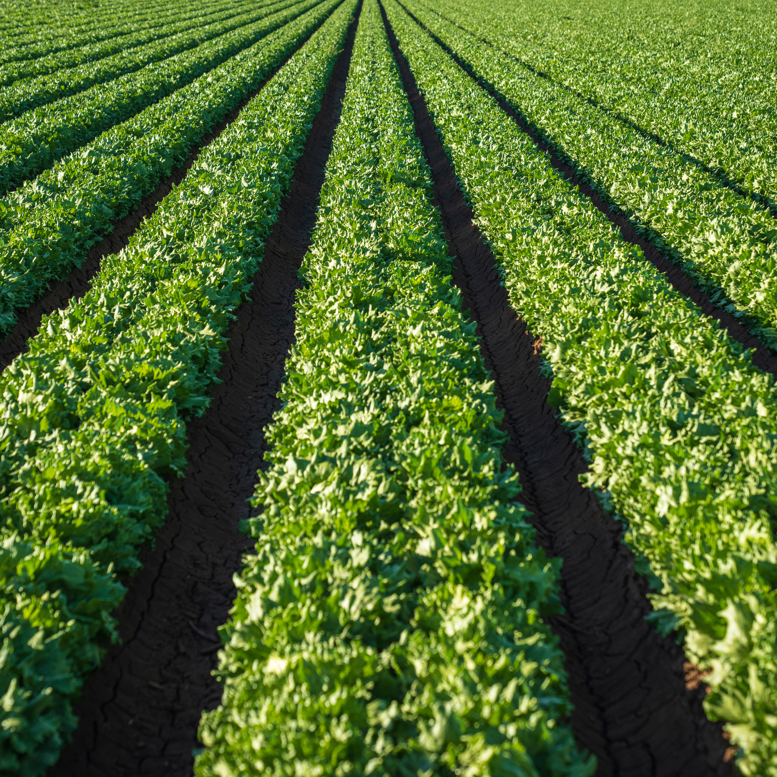
Ginyard International Co.
Home
Service
About Us
Contact
Agenda
01
Introduction
Methodology
Problem Statement
02
03
04
Dataset
05
Model/Technique/Algorithms
06
Evaluation Measure
Visualization
07
Conclusion
08

Slide 3
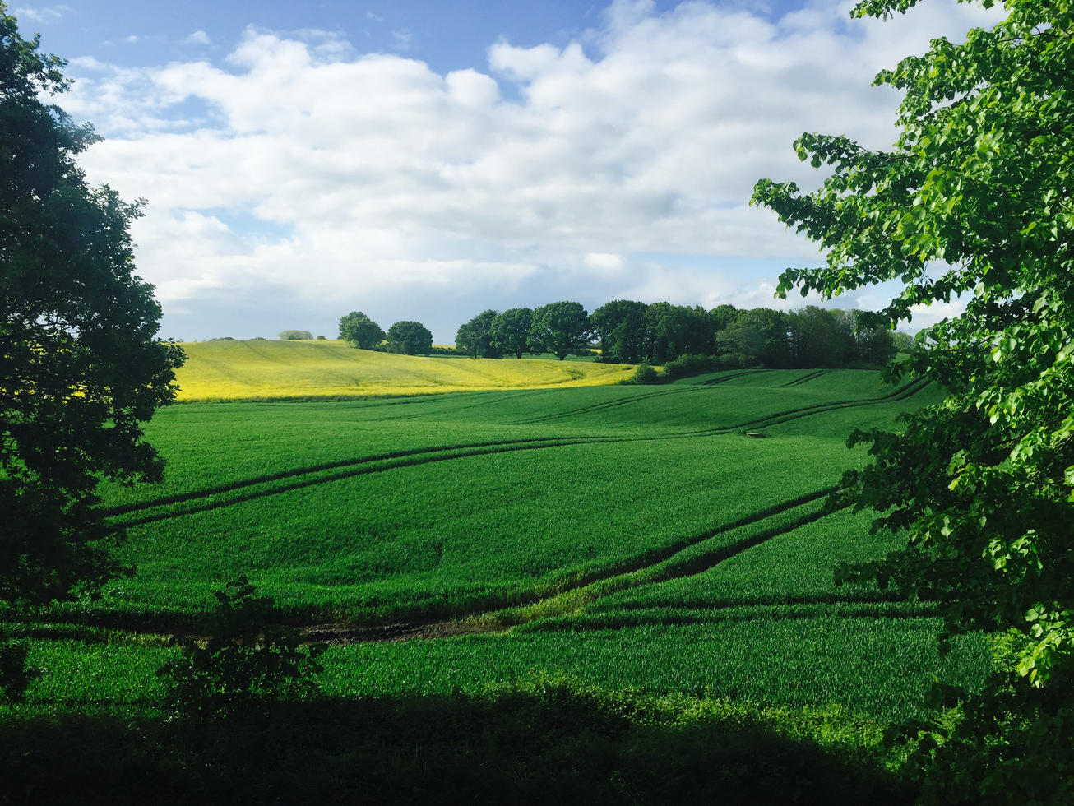

Ginyard International Co.
Home
Service
About Us
Contact
Crop Recommendation System
This analysis focuses on developing a crop recommendation system using a dataset that includes key environmental and soil factors. The data provides valuable information about soil nutrients, weather conditions, and other elements that impact crop growth and yield. The main objective is to identify the best crops suited to specific conditions, helping farmers make informed decisions. By leveraging data preprocessing, visualization, and predictive modeling, this study aims to support sustainable farming practices and improve agricultural productivity.

Slide 4

Ginyard International Co.
Home
Service
About Us
Contact
Problem Statement
To develop a crop recommendation system using environmental and soil parameters. The goal is to assist farmers in selecting the optimal crop based on various features such as soil nutrients, weather conditions, and water availability.
Problem Statement
Scaling

Slide 5
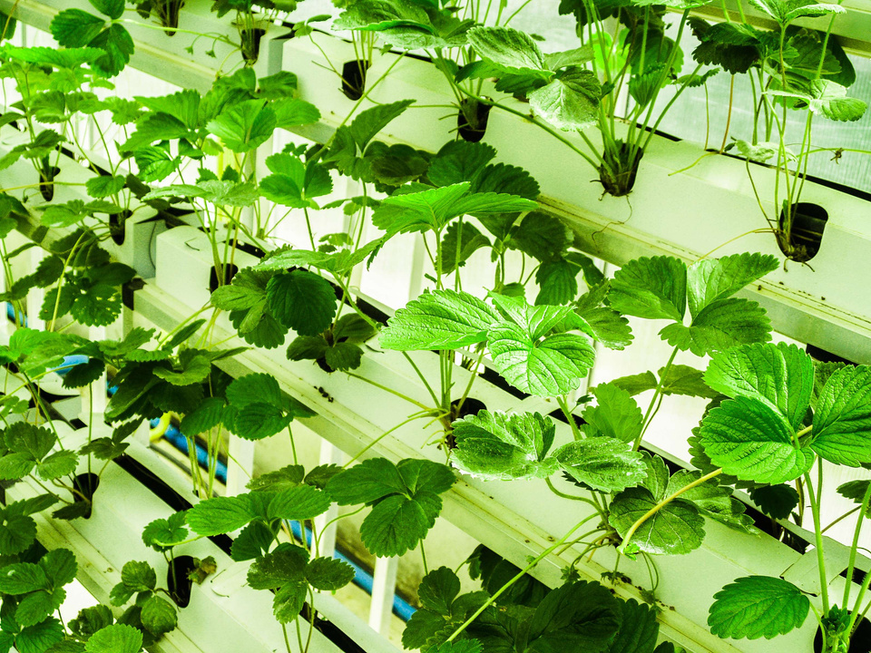
Ginyard International Co.
Home
Service
About Us
Contact
Methodology
01
Data preprocessing handling missing values, removing duplicates, etc.
02
Exploratory data analysis (EDA)
03
Feature selection to identify important predictors
04
Model selection and training using machine learning algorithms
05
Evaluation using appropriate metrics
06
Deployment of the recommendation system

Slide 6

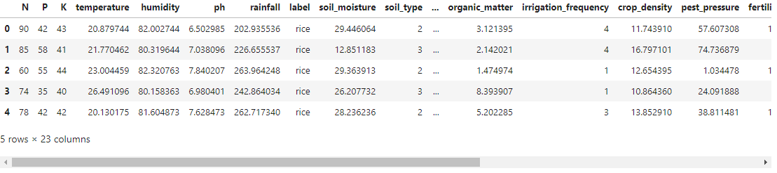
Ginyard International Co.
Home
Service
About Us
Contact
Data Set
The dataset consists of 23 features which includes
Soil properties (N(Nitrogen), P(Phosphorus), K(Potassium), pH(Potential Hydrogen), soil moisture, etc.)
Weather parameters (temperature, humidity, rainfall)
Additional factors (irrigation frequency, frost risk, etc.)
Target variable: crop type ('label')

Slide 7

Ginyard International Co.
Home
Service
About Us
Contact
Model/Technique/Algorithms
Data preprocessing techniques (scaling, encoding)
Hyper parameter tuning for model optimization
Cross-validation for robust evaluation
Model Selection
Logistic Regression
SVM
XGBoost
Random Forest

Slide 8
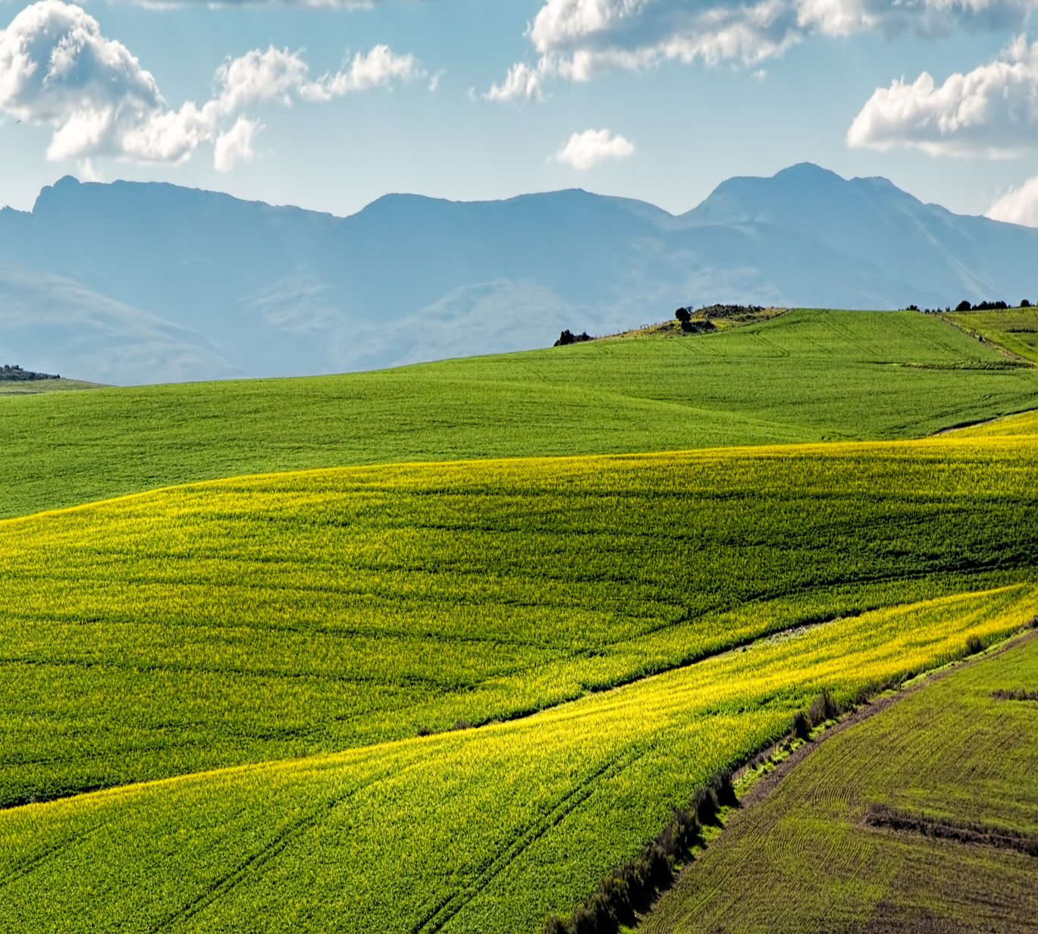
Ginyard International Co.
Home
Service
About Us
Contact
Evaluation Measure
1. Accuracy: Percentage of correct predictions
2. Precision, Recall, and F1-Score.

Slide 9

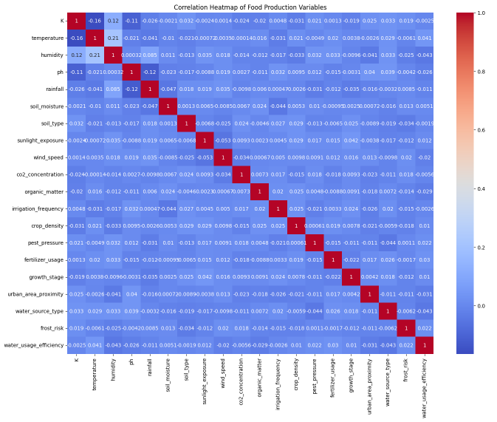
Ginyard International Co.
Home
Service
About Us
Contact
Visualization

Slide 10
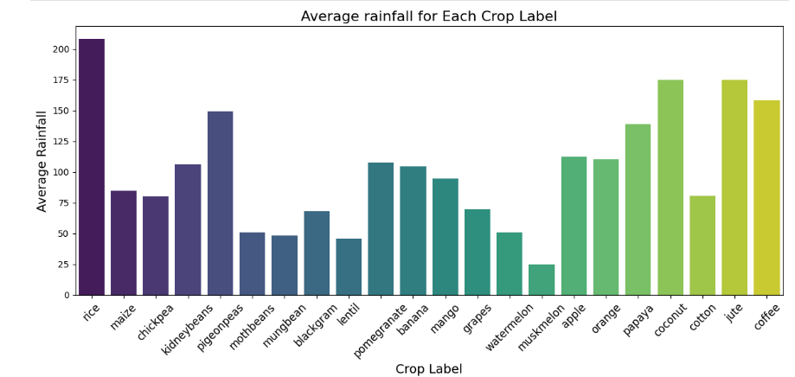
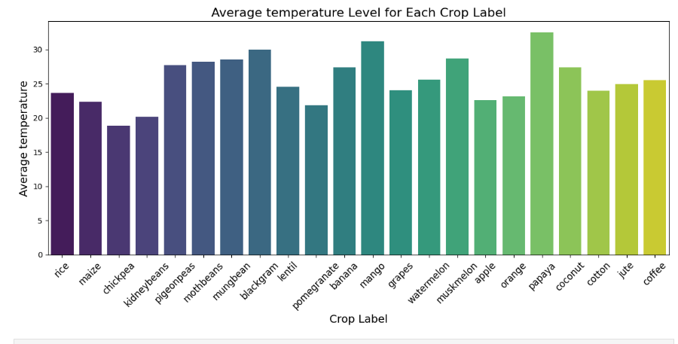
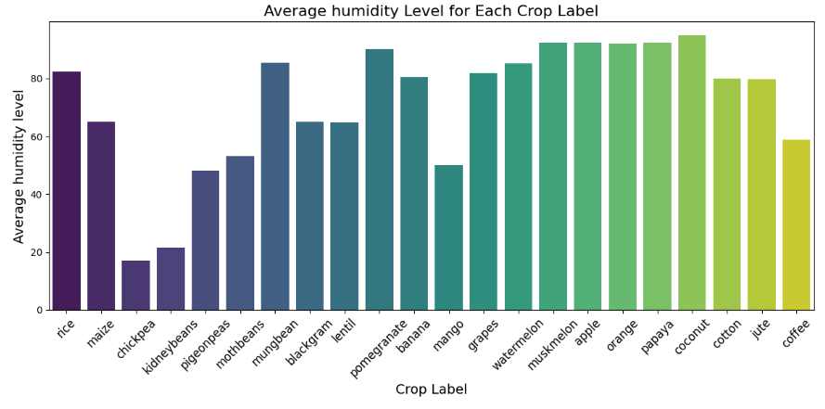
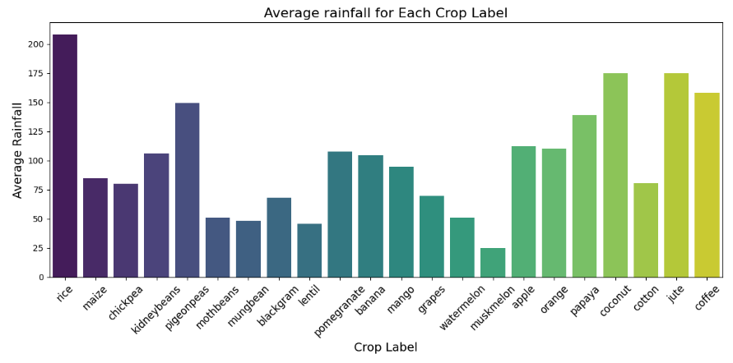
Feature and Target Variable Relationship
Home
Service
About Us
Contact

Slide 11
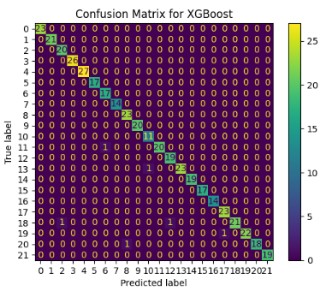
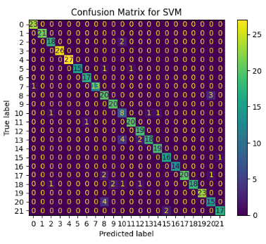
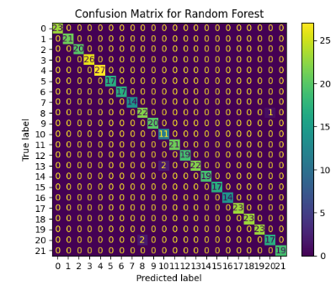
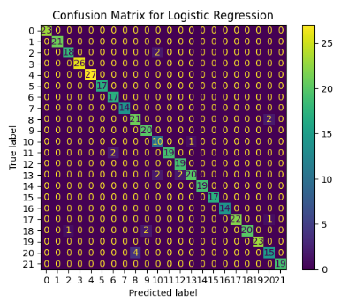
Ginyard International Co.
Home
Service
About Us
Contact
Confusion Matrix
We are showing CM for each model we are using in our project
CM XGBoot
CM Random Forest
CM SVM
CM Logistic Regression

Slide 12
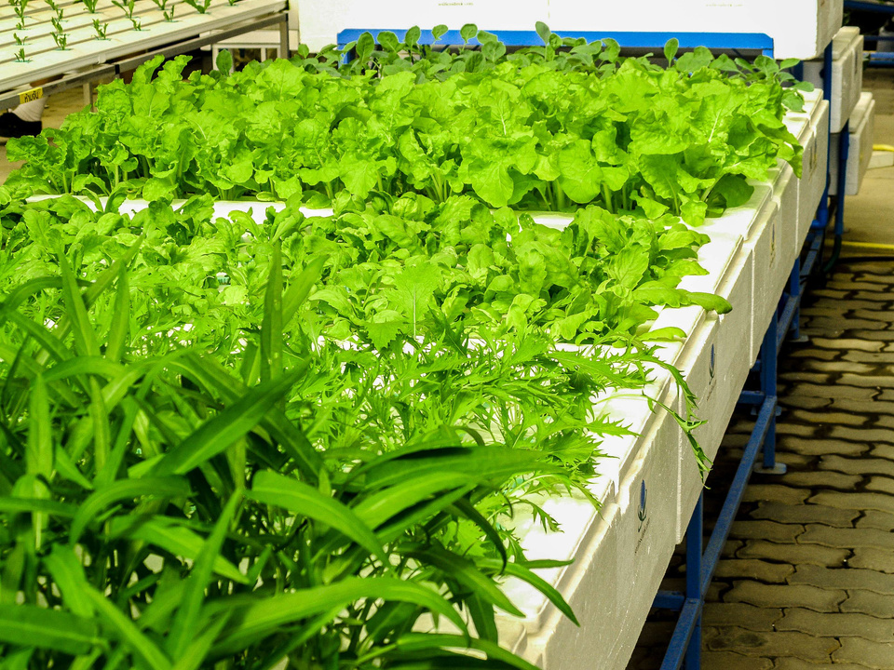
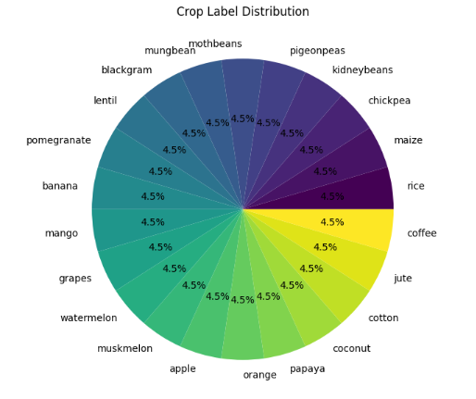
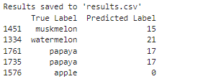
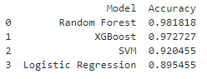
Ginyard International Co.
Home
Service
About Us
Contact
Crop Label Distribution

Slide 13
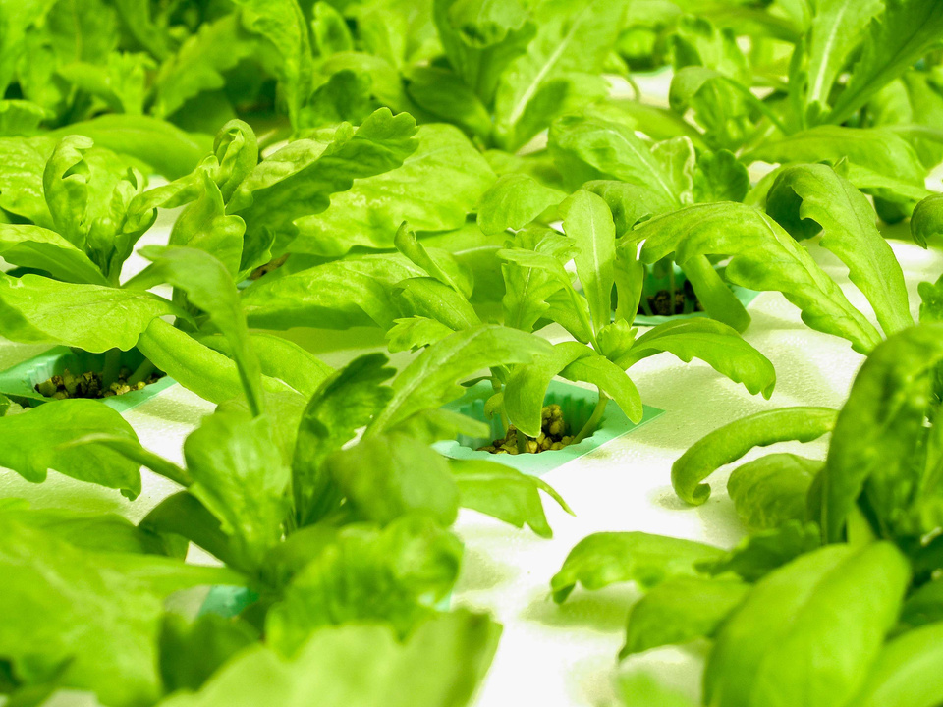
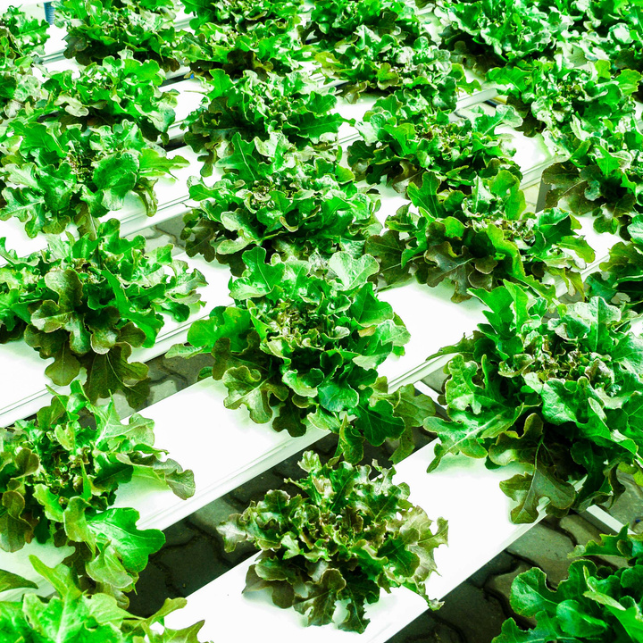
Ginyard International Co.
Home
Service
About Us
Contact
Conclusion
The analysis of the crop recommendation dataset showed that XGBoost and random forest were the most accurate model, making it the best performer. Important factors influencing crop recommendations were Nitrogen (N), Phosphorus (P), pH levels, and Rainfall, as revealed by feature importance analysis. The dataset included a well-balanced variety of crops, ensuring fair predictions. Confusion matrices and classification reports indicated strong model performance overall, with minimal signs of overfitting.

Slide 14
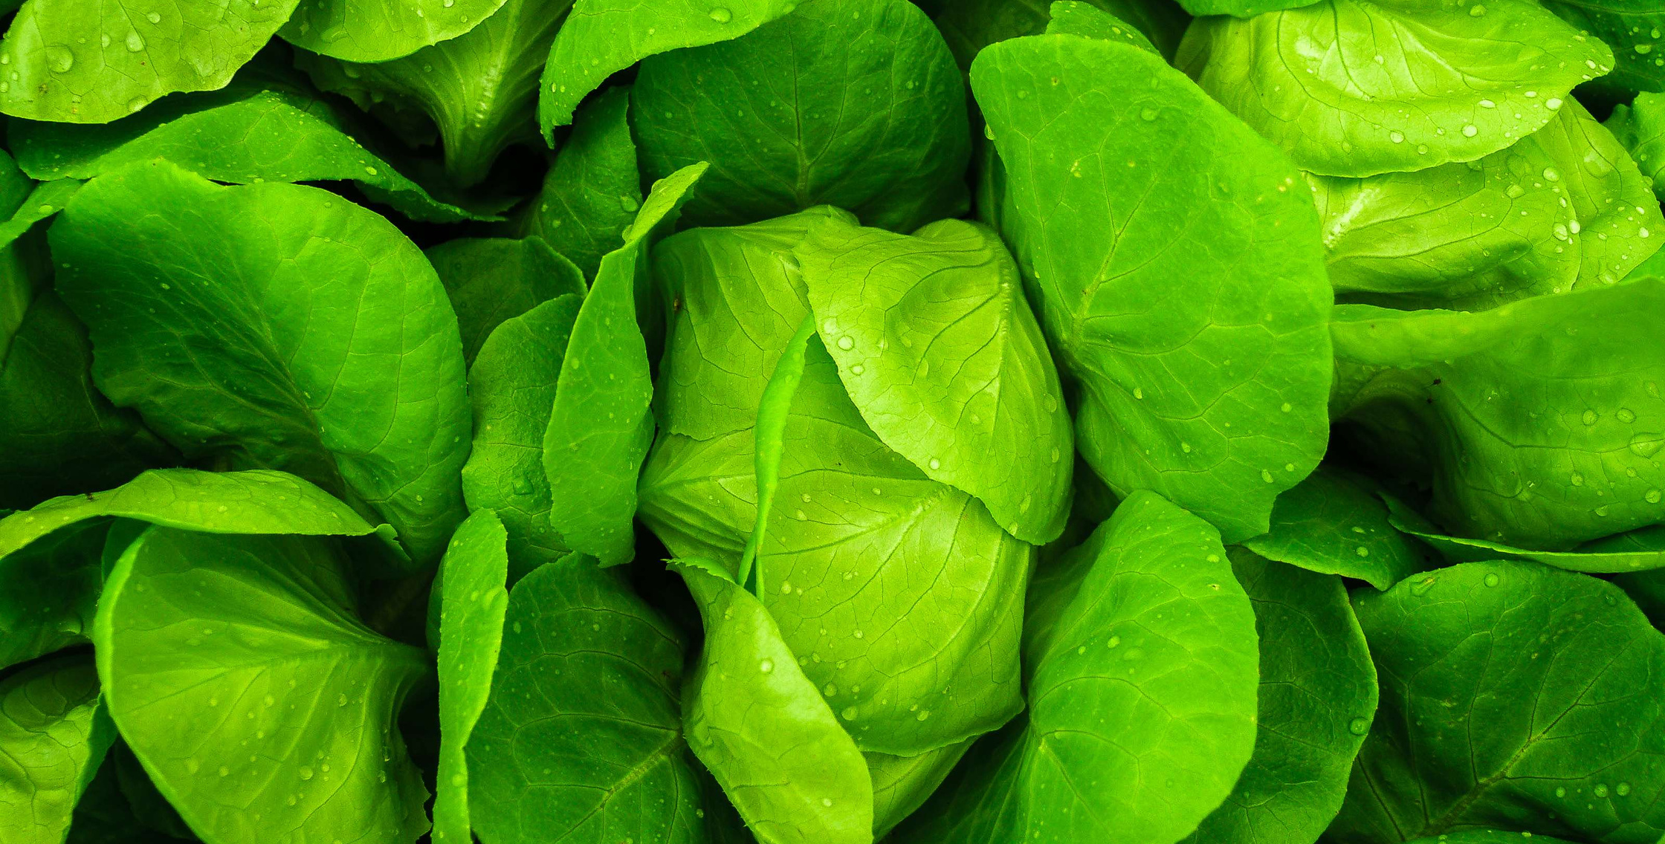
Ginyard International Co.
Home
Service
About Us
Contact
Thank You

